Slide 1
Asset Pack Showcase
AINT354 - Design for entertainment systems

Slide 2
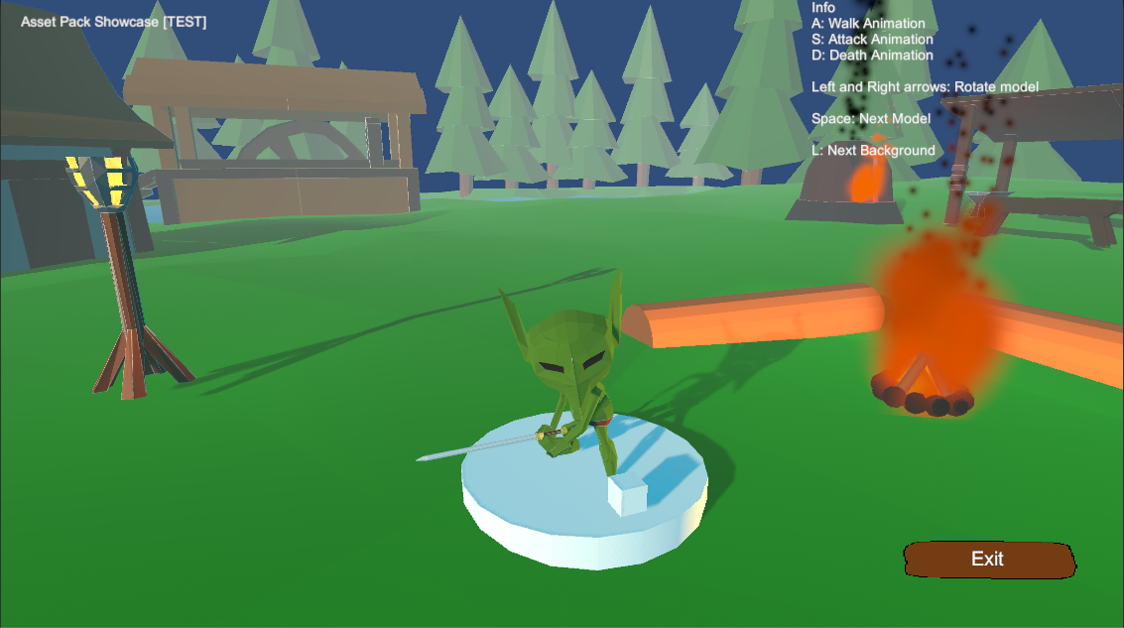
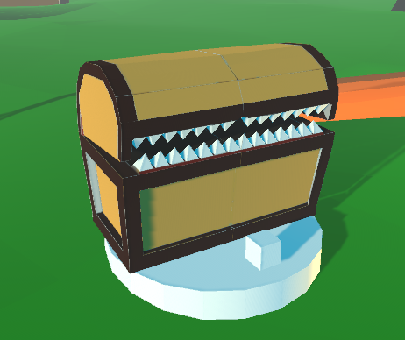
The project
Created an asset pack
Medieval/Fantasy themed prototyping
Aimed towards developers starting a new project
Asset Showcase to display models

Slide 3
Showcase controls
A,S and D to display model animations
L to change background
Left and Right arrows to rotate model

Slide 4
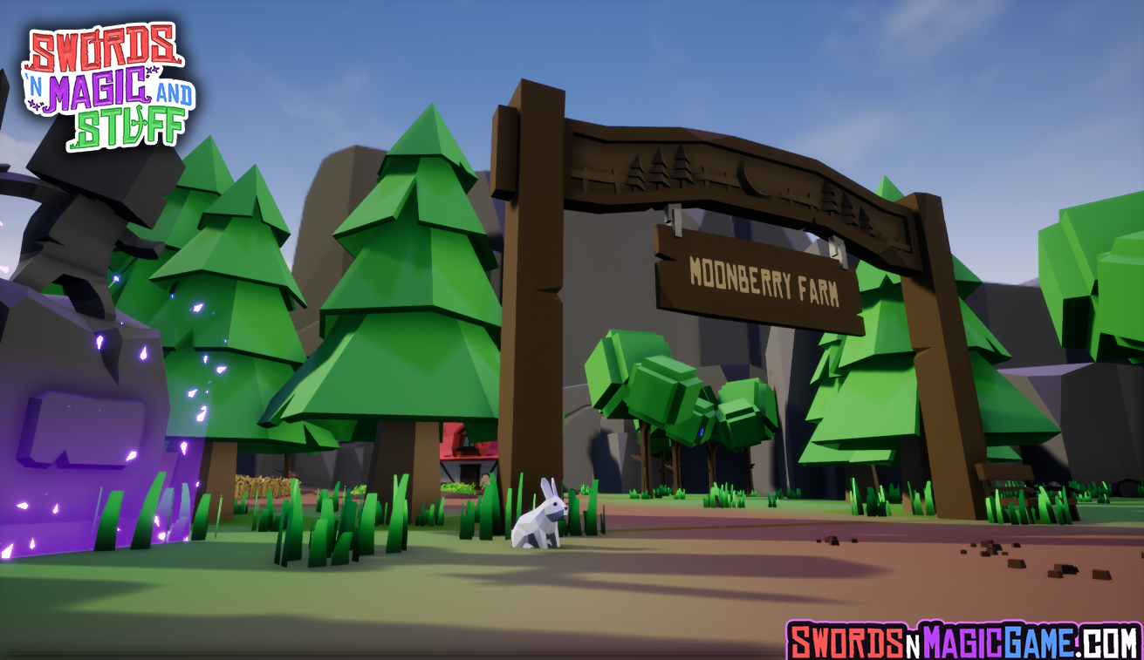
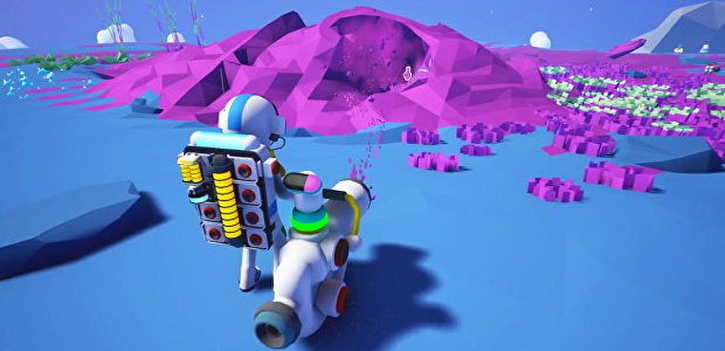
Design Inspirations
Overall Art style: Astroneer, Swords ‘n’ Magic and Stuff
Building Design style: Elder Scrolls V: Skyrim

Slide 5
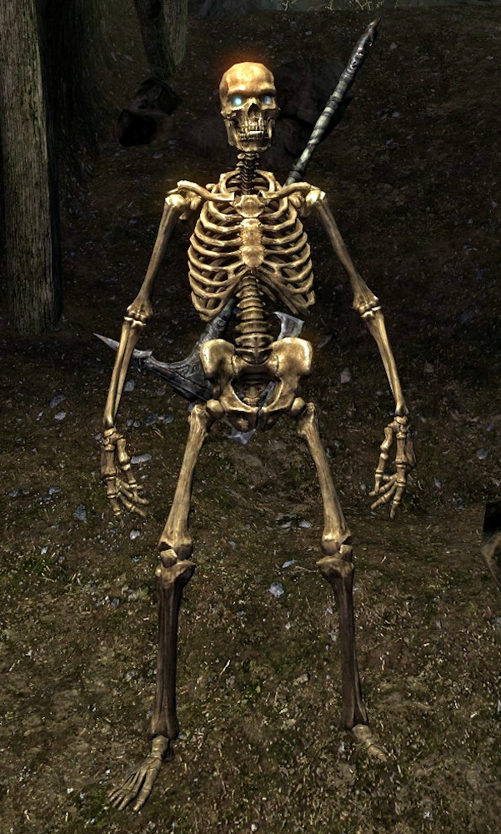
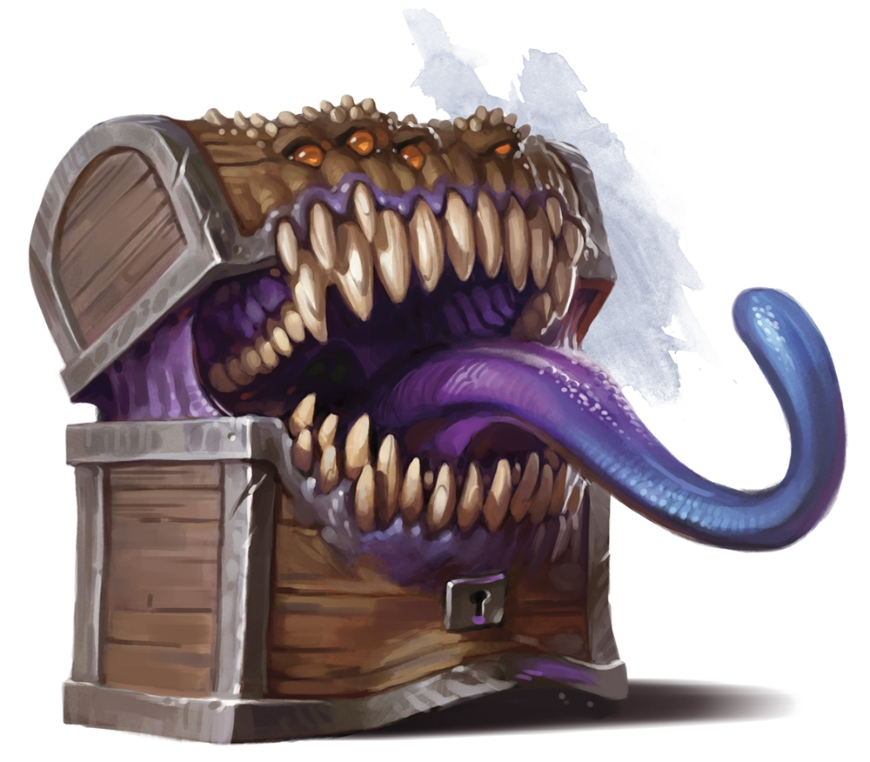
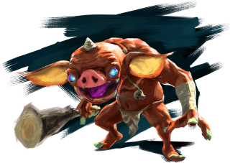
Design Inspirations
Skeletons: Basically every fantasy game made
Goblin: Bokoblins from BotW
Mimic: DnD

